Slide 1

Assessing the Efficacy of Automated Timetable Scheduling: A Case Study at the University of Ibadan.
Joseph Adebowale, Ifeoluwa Akinwusi, Akinfolarin Akinrinola

Slide 2



Introduction
Timetable scheduling significantly influences the daily lives of students and faculty, yet the traditional manual approach is fraught with complexities.
Our research focuses on "Assessing the Efficacy of Automated Timetable Scheduling: A Case Study at the University of Ibadan."
Join us as we explore the challenges, solutions, and the dynamic setting of the University in this examination of automated timetable scheduling.

Slide 3

AIM & Objectives
Assess the efficacy of automated examination timetabling in a real world setting
Our Objectives:
To implement generational genetic algorithm
Design and Implement a web-based interface to expose the algorithm for use by stakeholder.
Evaluating the effectiveness of the automated system in terms of the quality of timetables generated.
Assessing the time efficiency of the automated examination timetable generation process.
Soliciting and analyzing stakeholder feedback on the automated system and the timetables it produces.
Recommend strategies to implement and deploy such a system in other universities.

Slide 4
Review of Relevant Literature
Paper | Key Insights | Gap in Literature | Progression
Examination timetabling in British Universities: A survey by Burke et al. (1994) | Explored the complexities of examination timetabling, laying the foundation for understanding diverse challenges. | Recognized variations between and within institutions. | Marked a critical point in comprehending nuances of university scheduling.
A Genetic Algorithm Based University Timetabling System Burke et al. (1996) | Genetic Algorithm Based University Timetabling System | System was not used in real world setting | Provided valuable insights and methodologies for researchers
University Timetabling: Bridging the Gap between Research and Practice Barry McCollum (2006) | Emphasized the need to bridge the gap between timetabling research and educational requirements. Needed concrete solutions to integrate research and practice. | Pointed out the lack of algorithms capable of efficiently testing all possibilities. | Set the stage for a deeper exploration into identifying the gap and actively seeking ways to address it.

Slide 5
Review of Relevant Literature
Paper | Key Insights | Gap in Literature | Progression
A survey of search methodologies and automated system development for examination timetabling. Qu et al. (2009) | Surveyed search methodologies and automated system development for examination timetabling | Survey ws carried out on prevailing methodologies of that time | Contributed to the evolution of automated systems in examination timetabling
A review on genetic algorithm: past, present, and future Kumar et al. (2010) | Reviewed genetic algorithms, spanning past, present, and future |  | Enriched understanding of historical development and future prospects of genetic algorithms
Design and Implementation of a Web-Based Timetable System for Higher Education Institutions Nyagorme et al. (2021) | Designed and implemented Web-Based Timetable System for Higher Education Institutions | System lacked any formal form of validation from stakeholder | Provided insights into contemporary solutions, serving as a valuable reference

Slide 6
Review of Relevant Literature
Paper | Key Insights | Gap in Literature | Progression
Hayat et al. (2020) | Meticulously reviewed optimization algorithms for university course timetabling | Uncovered NP-hard complexity in the problem | Highlighted the emergence of heuristic techniques and meta-heuristics as pragmatic approaches
An Automated Scheduling System for University Lectures and Examinations. Iwara et al. (2018) | Introduced an automated system for lecture and examination timetabling but lacked comprehensive validation from university stakeholders. | Left a critical gap in understanding the practical usefulness of the proposed system. | Opened discussions on the importance of not only introducing new systems but thoroughly evaluating their impact on daily university operations, especially in timetabling.
Examination Scheduling System for Mapua University. Bleyn et al. (2022) | Proposed a web-based examination scheduling system at Mapua University, lacking an essential evaluation of its impact on timetabling and stakeholders. | Missed evaluating the holistic effects of the system on the timetabling process and stakeholders. | Emphasized the necessity of introducing innovations and thoroughly scrutinizing their implications on the broader academic ecosystem at Mapua University.

Slide 7

Methodology - Introduction
Here, we outline the research design, philosophy, type, methodology, strategy, sampling, and data collection methods, justifying each decision. The chapter also expounds on the analysis methods employed, addresses limitations, and concludes with a summary.

Slide 8
Methodology - Research Design
Research Philosophy
Research Type
Research Methodology
This study adopts a positivist research philosophy. Positivism aligns with the objective of objectively evaluating the effectiveness of the automated examination timetable system. Positivism emphasizes empirical observation and measurable outcomes, providing a robust foundation for this research's quantitative focus.
A deductive research type is employed. This choice is justified by the need to test existing theories and hypotheses regarding the effectiveness of automated examination timetabling systems. By deducing specific expectations from broader theories, this research aims to contribute empirical evidence to the existing body of knowledge.
A mixed-methods approach is chosen, combining both qualitative and quantitative methods. This approach enables a comprehensive assessment by capturing both numerical performance metrics and stakeholder perceptions. The combination of methods provides a holistic understanding of the automated system's impact.

Slide 9
Methodology - Research Design
Research Strategy
Sampling Strategy
Non-probabilistic sampling is selected due to its practicality and accessibility. Data will be collected from two faculties, namely the Faculty of Science and the Faculty of Technology. These faculties are chosen based on convenience and accessibility for the researchers, ensuring a feasible and manageable data collection process.
A case study strategy is employed, focusing on the University of Ibadan. This strategy facilitates an in-depth exploration of the specific context and allows for a detailed examination of the automated examination timetable generation system within the university's unique constraints and requirements.

Slide 10
Methodology - Data Collection Method
01
System requirements will be gathered through focus group interviews with department timetable officers. This method is chosen for its ability to elicit comprehensive insights into both hard and soft constraints, ensuring a thorough understanding of the automated system's specifications.
02
Historical Examination Timetable Data: Timetable data spanning from 2019 to 2022 will be collected to evaluate the system's performance over multiple academic years. This historical data provides a basis for comparative analysis and enables the identification of long-term trends and patterns.
03
System performance data will be collected through predefined metrics integrated into the automated system. This method ensures real-time and objective data on processing time, resource utilization, and conflict resolution, contributing to an accurate evaluation of the system's efficiency.

Slide 11
Methodology - Data Collection Method
SYSTEM REQUIREMENTS (Collected through Focus Group Interview)
Category | Interview Question
General Understanding | How would you describe the current process of generating examination timetables within your department? Can you highlight any specific challenges or pain points experienced in the manual timetable creation process?
User Needs and Preferences | What features or functionalities do you believe are essential for an effective automated examination timetable generation system? Are there any specific preferences or requirements your department has that should be considered in the system design?
Constraints and Rules | What are the critical constraints or rules that must be adhered to in the examination timetable creation process? Are there any department-specific rules or constraints that the system needs to accommodate?
Data Input and Integration | How do you currently gather and input data for the examination timetable creation? Are there any existing systems or databases that the automated system should integrate with for seamless data transfer?
Flexibility and Adaptability | How important is flexibility in adjusting the timetable to accommodate unexpected changes or constraints? Are there scenarios where manual intervention may still be required, and if so, under what circumstances?
User Interface and Experience | What are the key considerations for a user-friendly interface for department timetable officers? How do you envision interacting with the automated system, and what features would facilitate ease of use?

Slide 12
Methodology - Analysis Methods
CONTENT ANALYSIS | COMPARATIVE ANALYSIS | QUALITY ANALYSIS
Content analysis will be employed to extract functional and non-functional requirements from the requirement gathered from stakeholder. The utilization of UML (Unified Modeling Language) and the implementation through the waterfall model are justified for their systematic and structured approach, ensuring clarity in representing system requirements and facilitating a step-by-step development process. | Comparative analysis will be utilized to assess specific performance metrics between the automated system and the manual method. This approach involves the definition of control variables which will be used to compare the results generated by the system to historic timetable data. | Quality analysis, conducted through a survey, aims to measure stakeholder perceptions of system quality. Variables such as reliability, usability, flexibility, and correctness will be assessed. This method provides valuable insights into the subjective experiences and satisfaction levels of key stakeholders.

Slide 13
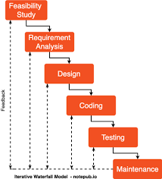
Methodology - Analysis Methods (Water Fall)

Slide 14
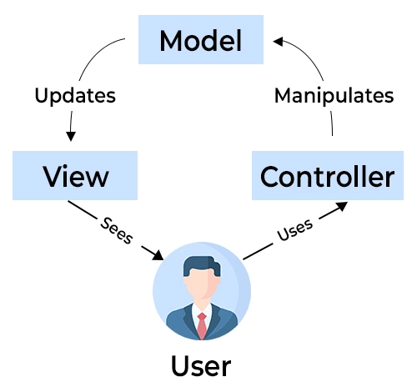
Methodology - Analysis Methods (MVC Architecture)

Slide 15
Methodology - Analysis Methods
ID | Description
F1 | The system shall accurately replicate the manual process of generating examination timetables, including room allocations, faculty preferences, and time constraints.
F2 | The system shall provide an automated conflict resolution mechanism to address challenges related to resource conflicts, such as overlapping schedules for shared facilities.
F3 | The system shall include features for automated scheduling, considering factors like faculty preferences, room capacities, and course-specific constraints.
F4 | The system shall allow customization based on department preferences, providing configurable options for defining soft constraints such as priorities, and preferences.
F5 | The system shall enforce constraints and rules, such as maximum consecutive hours for examinations, minimum gaps between exams, and adherence to university policies.
F6 | The system shall offer an intuitive web-based interface for department timetable officers to input examination data, with features like drag-and-drop functionality and real-time validation.
F7 | The system shall integrate seamlessly with existing university systems, including student course registration portal systems ensuring accurate and timely data transfer.
F8 | The system shall allow real-time adjustments to the timetable to accommodate unforeseen changes or constraints, with notifications and alerts for conflicting schedules.
F9 | The system shall provide accessible support resources, including a knowledge base, FAQs, and a dedicated helpdesk, to assist users in adapting to the new system.
F10 | The system shall implement access control and ensure that only department and faculty officers are able to add new soft constraints
F11 | The system shall automatically cater for and report students with conflicting examination schedules for manual consideration.

Slide 16
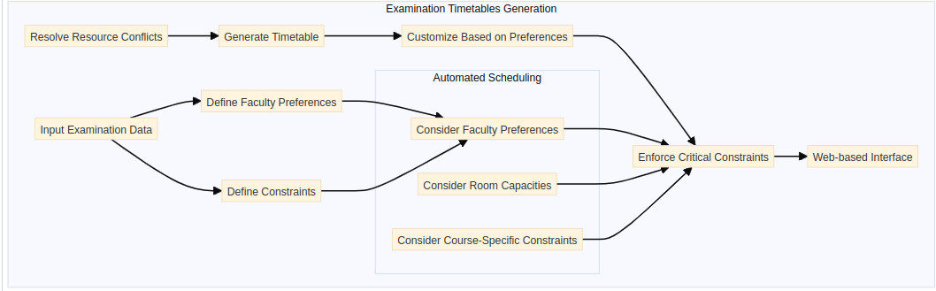
Methodology - Analysis Methods (Mind Map)

Slide 17
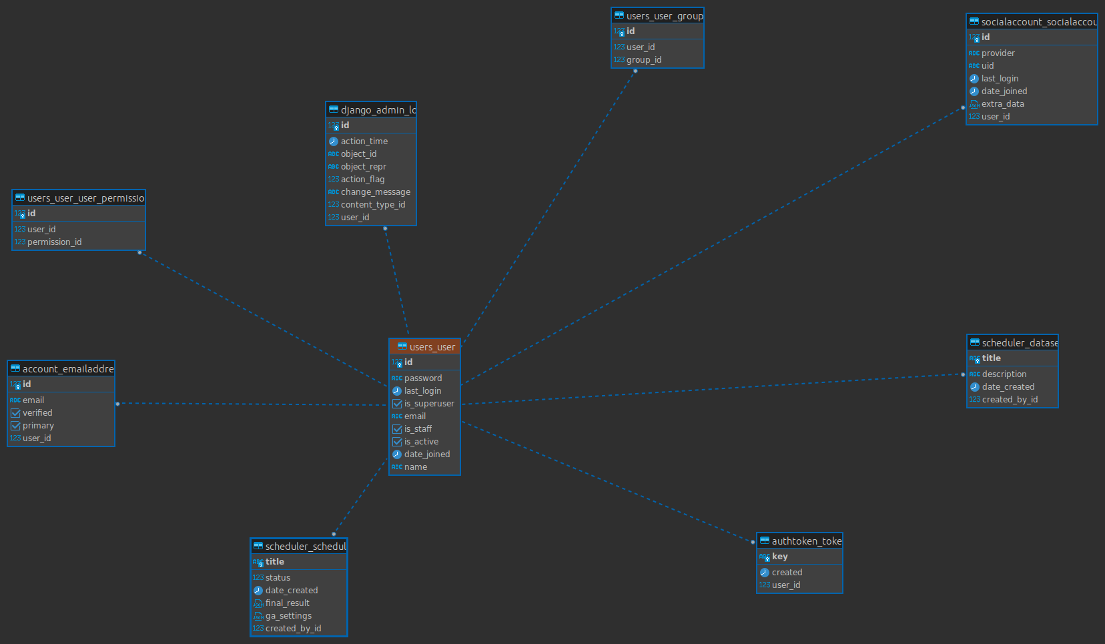
Methodology - Analysis Methods (ER Diagram)

Slide 18
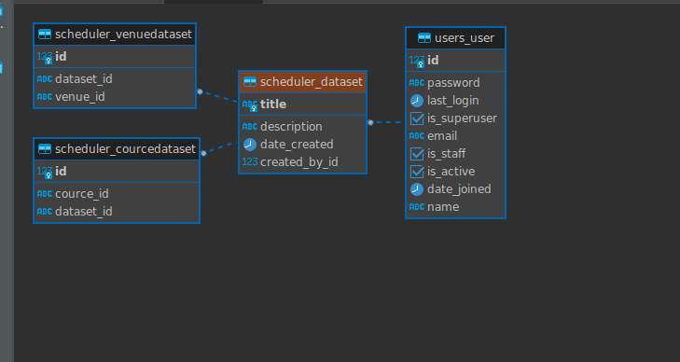
Methodology - Analysis Methods (ER Diagram)

Slide 19
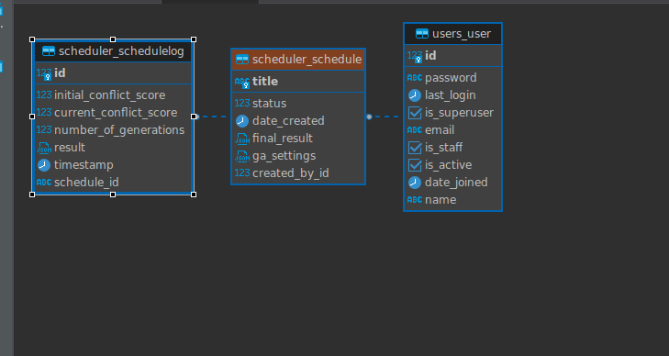
Methodology - Analysis Methods (ER Diagram)

Slide 20
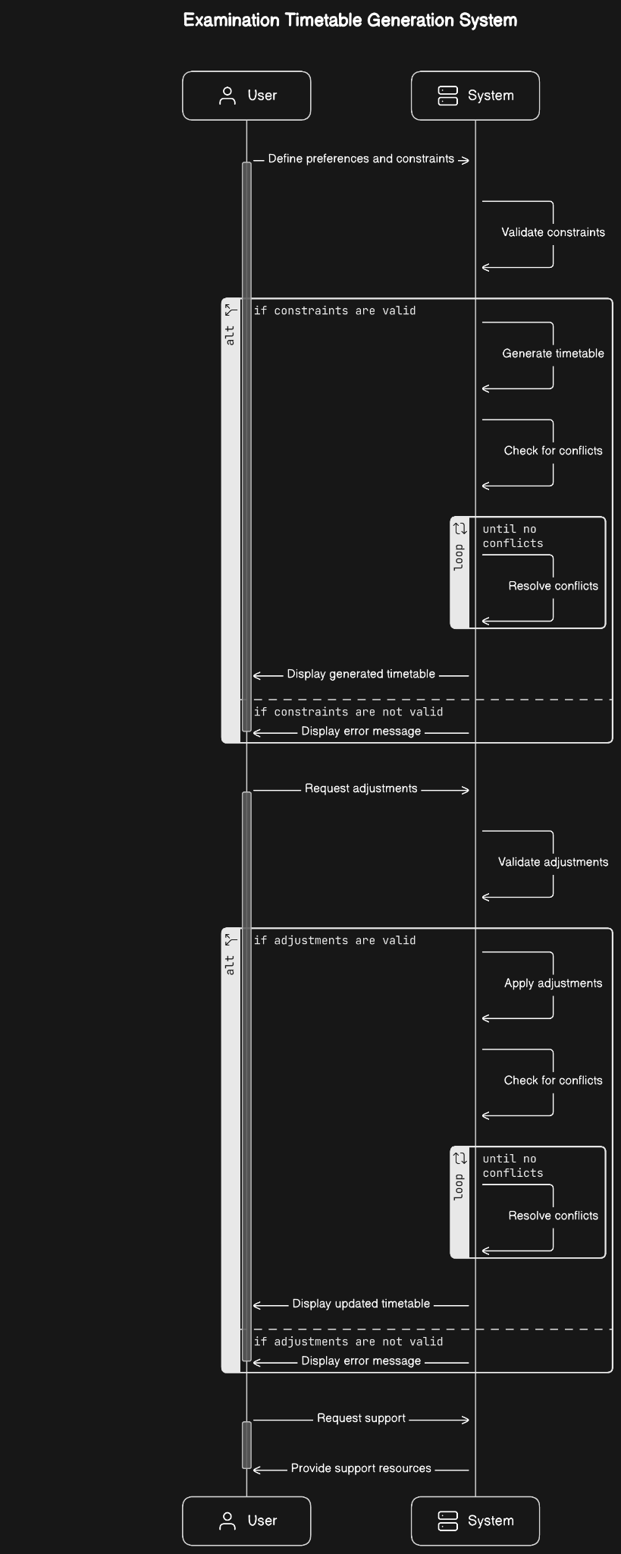
UML Sequence Chart

Slide 21
Conclusion and Summary
This chapter presents a robust methodology designed to rigorously evaluate the automated examination timetable generation system at the University of Ibadan. The chosen methods align with the research objectives, ensuring a thorough and insightful analysis of the system's effectiveness. The subsequent chapters will delve into the findings and implications derived from the implemented methodology.

Slide 22
Limitations and Shortcomings
While every effort is made to ensure a comprehensive assessment, limitations include potential biases in stakeholder feedback, reliance on historical data accuracy, and the dynamic nature of university timetabling, which may introduce unforeseen variables.

Slide 23
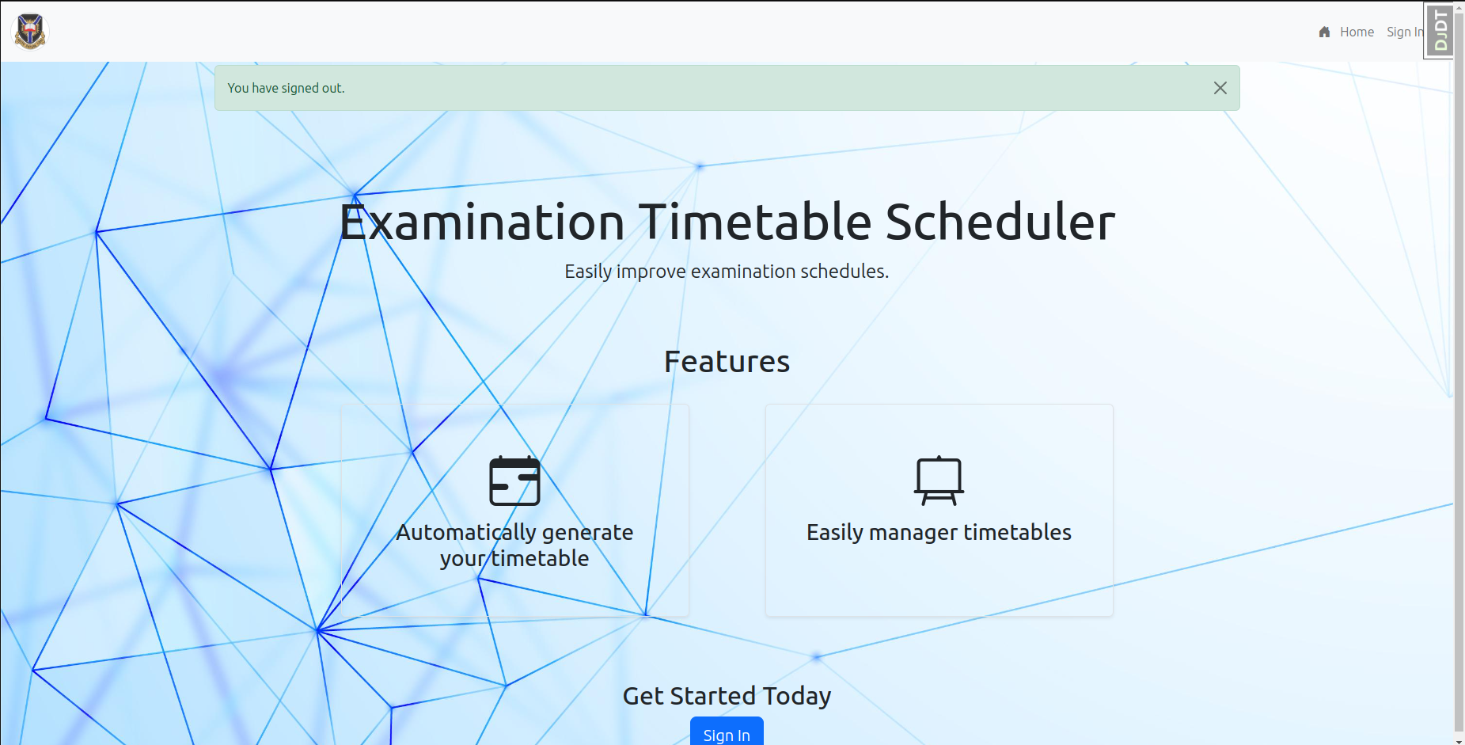
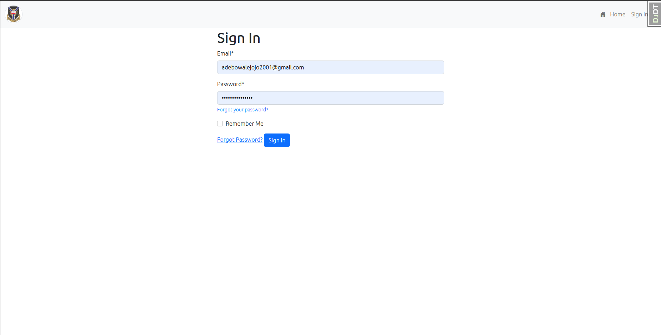
Results (Implementation)

Slide 24
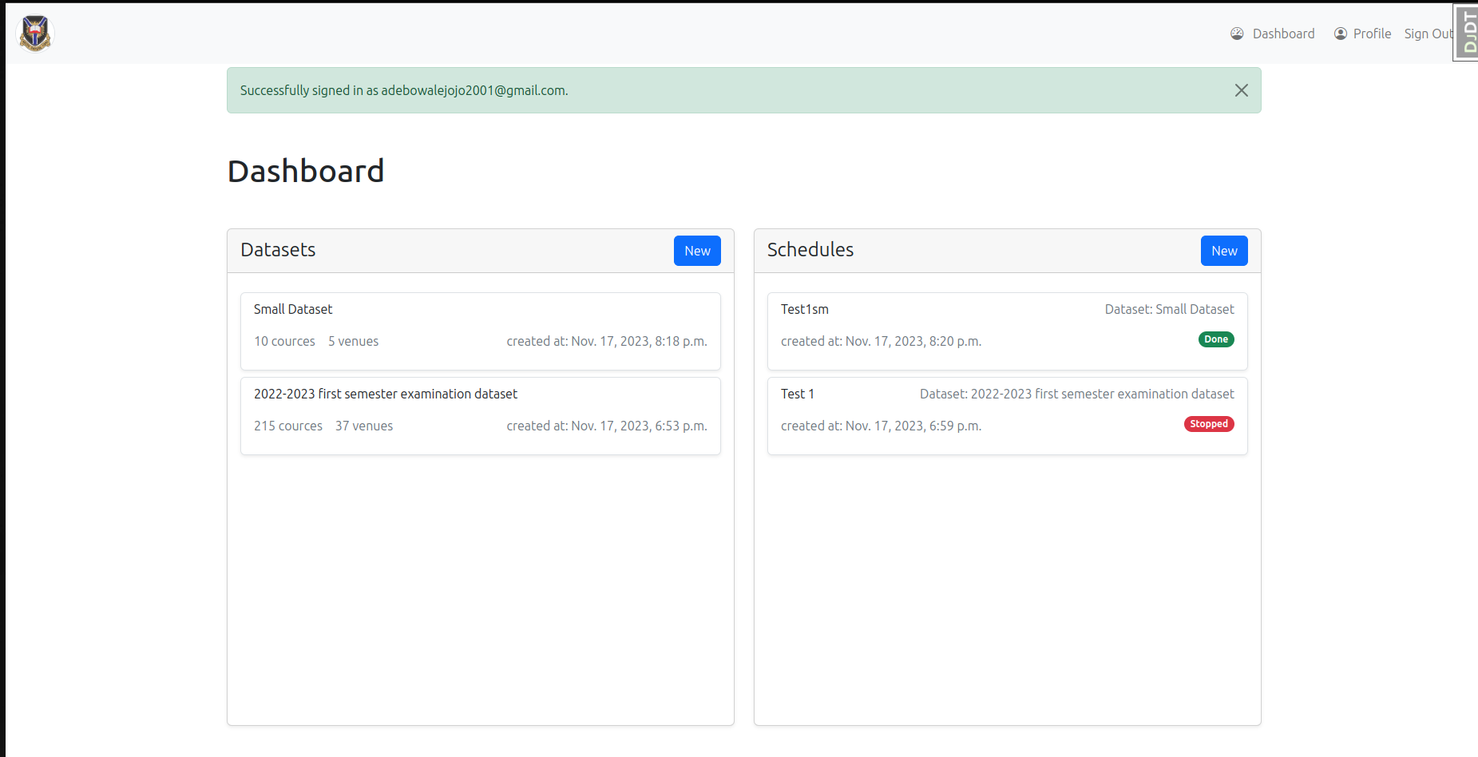
Results (Implementation)

Slide 25
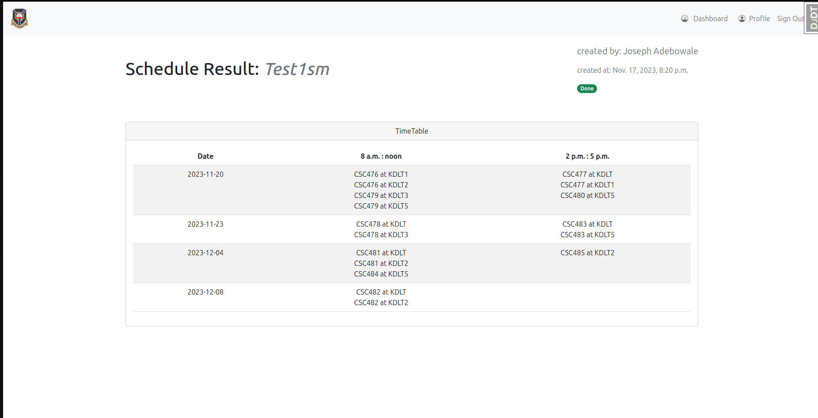
Results (Implementation)

Slide 26
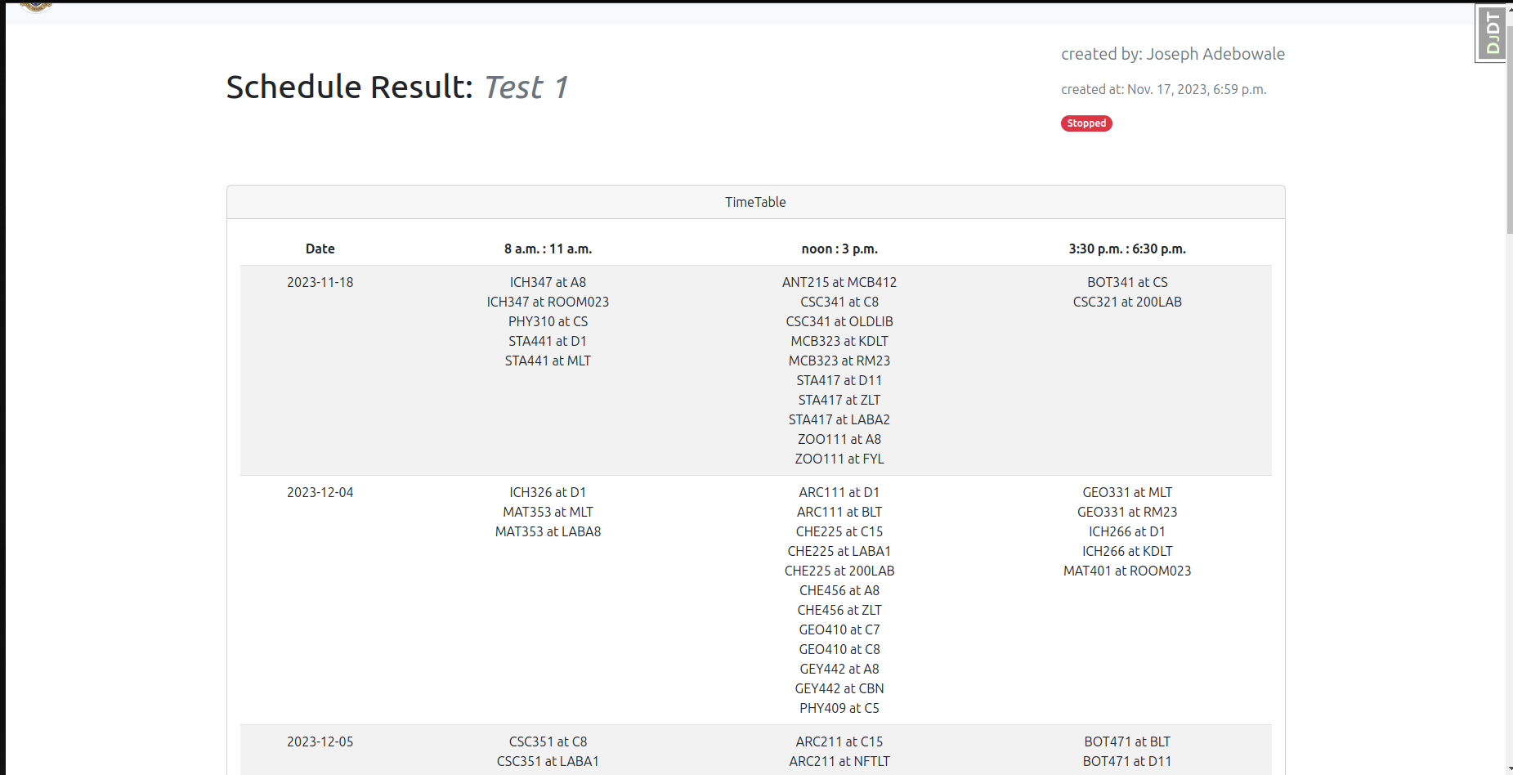
Results (Implementation)

Slide 27
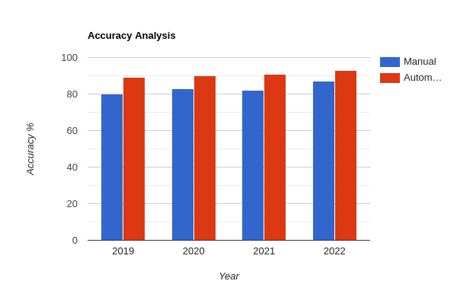
Results (Accuracy Analysis)

Slide 28
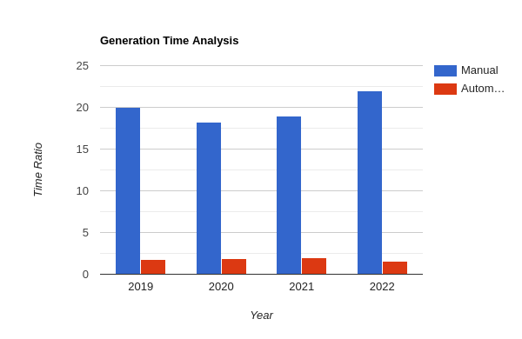
Results (Time Analysis)

Slide 29
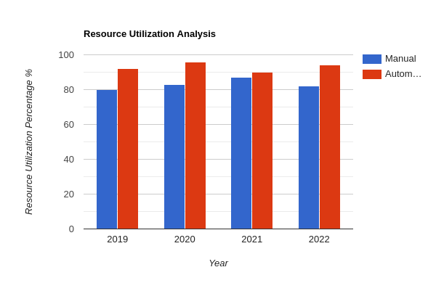
Results (Resource Analysis)

Slide 30
Limitations
Limitations of the Study | Description | Mitigation

